Slide 1
Bray Team Week 13 Update
Avery Haynes, Locke Lehmann, Travis Carlson, Cody Sims, Zachary Walker, Michael Hager
4/22/2024

Slide 2
Weekly Deliverables
Tasks | Lead | Percentage Done | Notes
Begin potentiometer validation testing | Avery/Michael | 50% | Do more test runs.
Strain Gauge Measurement | Zack/ Michael | 75% | Attached boards and jumper wires, get readings
Test motor system | Cody/Travis | 90% | Got readings, working on equation for torque.
Hall effect sensor Test | Locke/Travis | 50% | Get data readings.

Slide 3
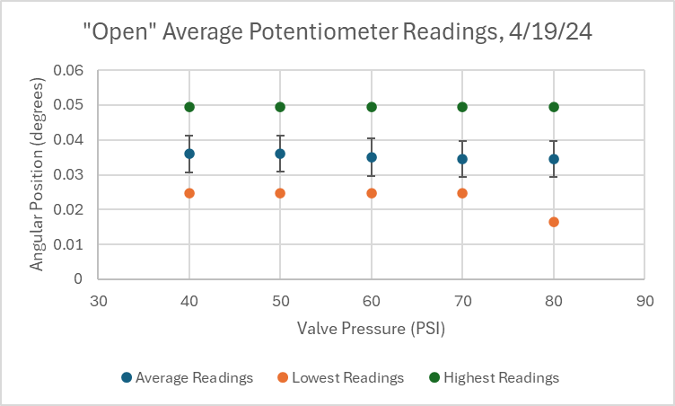
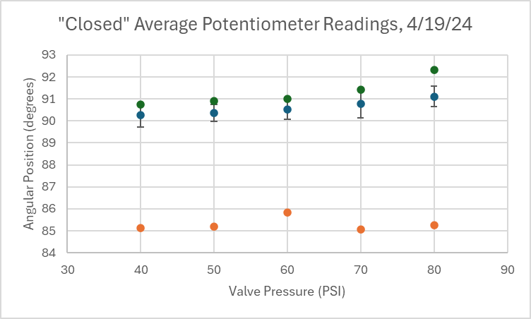
Potentiometer
Epoxied potentiometer into valve - worked very well
Got consistent readings for 150+ actuations - good data

Slide 4
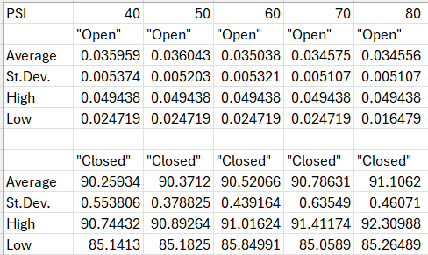
Potentiometer
30-35 turns for each PSI for significant data analysis
All st.dev’s less than 0.7 (good as Bray wants less than +/- 2 degree error)

Slide 5
Hall Effect Sensor
Asked Bray’s engineers what they thought about code - discussing today with them after studio

Slide 6
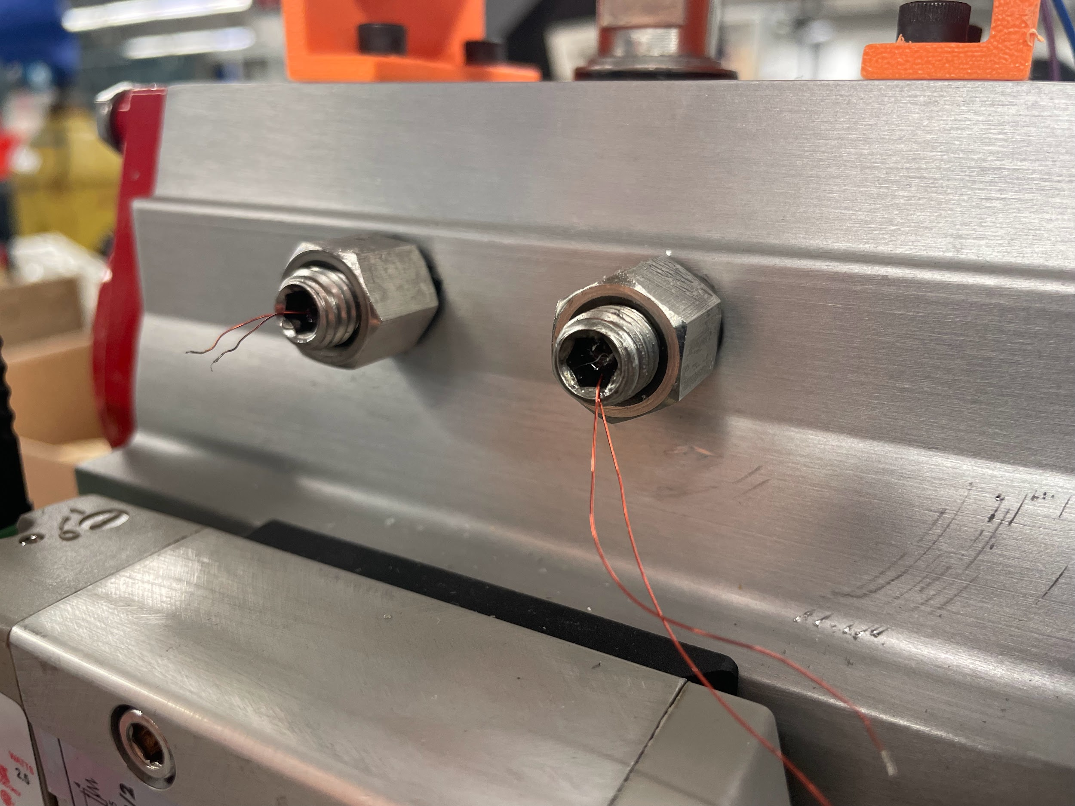
Strain Gauges
Successfully re-inserted new strain gauges into bolts
Readings do not change though when bolts are hit
Possible physical issue but
will continue to investigate

Slide 7
Electric Motor
Bought current voltage sensors (cheap, no biggie)
Current generated by a ¼ turn too small to read with basic current sensors.
Voltage sensors reduced noise in the voltage readings

Slide 8
Final Presentation
Thursday, April 25th
1-2 PM (room reserved from 12:30-2:30 PM)
ZACH 215 (13 person capacity)
Sent parking passes to Bray engineers

Slide 9
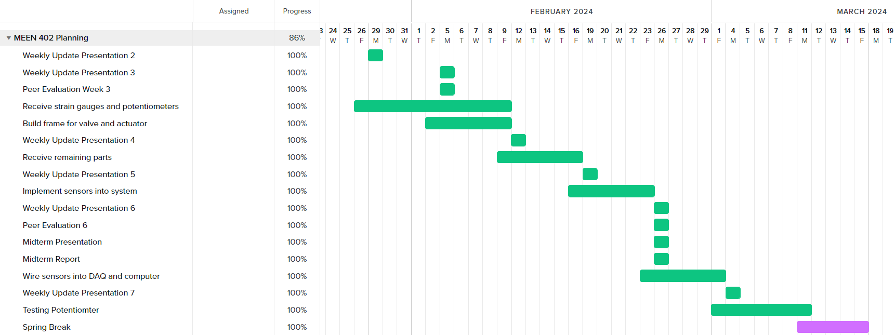
Gantt Chart

Slide 10
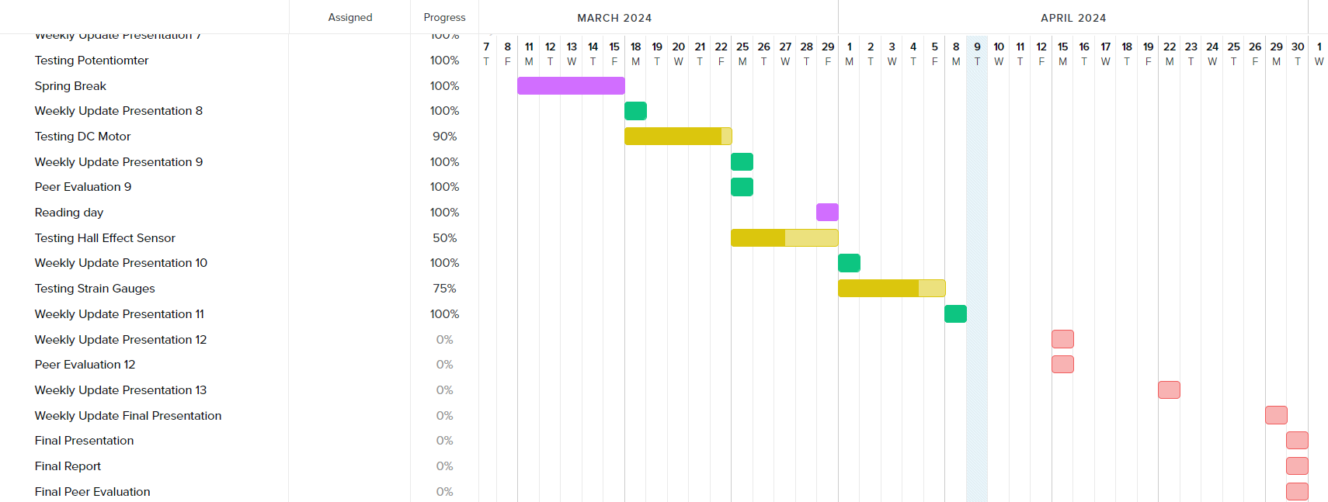
Gantt Chart

Slide 11
Next Week’s Deliverables
Finish everything.

